Slide 1
EN 61000-4-6
Immunity to
conducted disturbances,
induced by radio-frequency fields

Slide 2
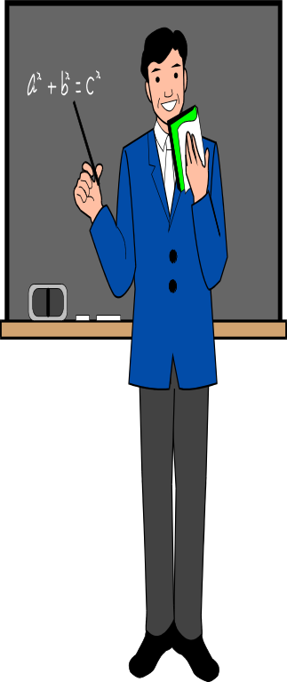
Scope:
Radio frequency(RF): 9kHz-80Mhz
At least one conducting cable,
such as mains supply, signal line or
earth connection

Slide 3

General
Source of disturbance:
RF trasmitters
Disturbed equipment:
small compared with the wavelength, such as mains, communication lines, interface cables
Coupling and decoupling devices:
common-mode impedance of 150Ω

Slide 4

Definitions:
Clamp injection:
-current clamp
-electromagnetic clamp ( EM-clamp )
Common-mode impedance
Eletromotive force (e.m.f)
Voltage standing wave ratio (VSWR)

Slide 5

Test level
No test in frequency range 9kHz to 150kHz
Test in frequency range 150kHz to 80MHz:
Level 1: U=1V, 120dBμ V
Level 2: U=3V, 130dBμ V
Level 3: U=10V, 140dBμ V
Level X open level
Refer to Annex C for selecting level

Slide 6
Test equipment:
Generator
2. Coupling and decoupling devices
3. Verification of common-mode impedance at the EUT port of coupling and decoupling devices
4. Setting of the test generator

Slide 7

Generator:
RF signal generator
Attenuator T1
RF switch, S1
Broadband power amplifier
Low-pass filters
Attenuator T2

Slide 8
characteristics of generator (table 2)
Output impedance (50Ω, VSWR≤1,2)
Harmonics and distortion
more than 15dB below carrier level
Amplitude modulation
80%±5% in depth by 1kHz±10% sine wave
Output level
cover test level, see annex E

Slide 9
Coupling and decoupling devices:
Function: couple the disturbing signal to the various
cables connected to the EUT
What is CDN?
Common-mode impedance: table 3

Slide 10
Coupling and decoupling devices:
Direct injection (see Page 22, Figure 5b)
via 100Ω resistor
see page 38. Figure D.1

Slide 11
Coupling and decoupling devices (CDNs):
CDN for power supply lines
not for high power and complex supply system
See page 38, Figure D.2
CDN-M1
CDN-M2
CDN-M3

Slide 12
Coupling and decoupling devices (CDNs):
CDN for unscreened balanced lines
see Annex D. Figure D.4, D.5, D.6
CDN-T2
CDN-T4
CDN-T8
For balanced multi-pair cables, clamp injection

Slide 13
Coupling and decoupling devices (CDNs):
CDN for unscreened non-balanced lines
see Annex D. Figure D.3
CDN-AF2 ( for a cable with 2 wires )
For balanced multi-pair cables, clamp injection

Slide 14
Coupling and decoupling devices :
Clamp injection
see Figure 6, page 24
see subclause 7.2 for application
Current clamp
EM-clamp
See Annex A for more detail

Slide 15
Coupling and decoupling devices:
CDN for unscreened balanced lines
see Annex D. Figure D.4, D.5, D.6
CDN-T2
CDN-T4
CDN-T8
For balanced multi-pair cables, clamp injection

Slide 16
Verification of Zce:
Network analyzer or impedance meter (50Ω)
Setup and procedure
refer to 6.3 and figure7a, 7b
Limits is table 3
Insertion loss of 150Ω to 50Ω adaptor
see figure 7.c for principle

Slide 17
Setting of generator:
Setting of the output level
see figure 8
Umr=Uo/6±25%, linear
Umr=Uo-15,6dB±2dB, logarithmic

Slide 18
Setting of generator:
Setting of the output level
see figure 8
For current clamps in 50Ω
Umr=Uo/2±25%, linear
Umr=Uo-6dB±2dB, logarithmic

Slide 19
How to select injection methods and test points:
Select Injection methods
Refer to Figure 1

Slide 20
How to select injection methods and test points:
Select test points
Using the most sensitive cable configuration

Slide 21
How to select injection methods and test points:
Procedure for clamp injection
See clause 7.2, 7.3

Slide 22
How to select injection methods and test points:
EUT comprising a single unit
Line length is about 0.1m to 0.3m from EUT
EUT comprising several units
Preferred method: test separately
alternative method: as one unit

Slide 23
Test procedure:
EUT is in its intended operating and climatic conditions
Non excited RF input ports with 50Ω load
Sweep rate ≤ 1,5x10⁻³decade/s
Step size ≤1%
Dwell time

Slide 24
The END

